Slide 1

Linux Server Health Monitoring & Alert System
Team Members:
1. Shivam Yadav – 2411021061438
2. Arya Nileshkumar Manoj – 2411021061473
3. Shrikrushna Pramod Bhise – 2411021061163
Name of the Mentor: Prof. Kusuma J
Linux System Administration (E1ITA307)

Slide 2

Agenda
Introduction
Problem Definition & Proposed Methodology
  Problem Statement / Scope of the Project
  Proposed Idea / Solution and Objectives
  Hardware Requirements
  Software Requirements
Process / Flow / Design Diagram
Proposed Modules
Experimentation, Results and Discussion
Conclusion & Future Directions
References

Slide 3

Introduction
Servers need regular health checks of CPU, RAM, disk, logged-in users and running processes. On Linux each check needs a different command (top, free, df, ps, who).
Beginners have to remember many commands and often notice a problem only after the system has slowed down or failed.
This project provides two interfaces for Ubuntu: a menu-driven Bash terminal tool and a Flask web dashboard. Both collect the readings in one place, compare them with user-set thresholds and show clear OK / WARNING alerts.
Every check can be saved as a timestamped report and an activity log, and cron can run the checks on a schedule. The tools are read-only and need no sudo.

Slide 4

Problem Statement / Scope of the Project
Problem: Checking a Linux server means running and remembering many separate commands. There is no automatic alert and no record of what was checked.
Beginners often see high CPU, RAM or disk usage only after the server slows down.
In scope
  CPU, RAM, disk, uptime, logged-in users, top processes and systemd service status of the local Ubuntu machine.
  Alerts against configurable thresholds; timestamped reports and an activity log; a terminal tool and a 7-tab web dashboard.
Out of scope
  Monitoring remote servers, and changing the system in any way (no kill, restart or sudo).
  Long-term history and e-mail / SMS alerts: the tools show current readings (cron can repeat checks and save reports).

Slide 5

Proposed Idea / Solution
Terminal tool, server_monitor.sh: an 11-option numbered menu (summary, CPU, memory, disk, uptime / users / processes, service check, thresholds, alerts, report, logs, exit). The options --check and --report run it from cron.
Real readings: /proc/stat (CPU), /proc/meminfo (RAM), df (disk), ps, who, uptime and systemctl.
Alert rule: usage ≥ threshold gives WARNING, below gives OK, and a value that cannot be read gives UNAVAILABLE. Default thresholds are 80 % for CPU, RAM and Disk and can be changed from the menu.
Saved output: reports, the activity log and config.conf live in one data/ folder shared by both tools.
Web dashboard: Flask app web/app.py with 7 tabs (dashboard, processes, network, service check, thresholds, reports, logs). Gauges refresh every 3 seconds; it listens on localhost by default.

Slide 6

Objectives of the Idea / Solution
Read CPU usage from two /proc/stat samples taken 1 second apart
Read RAM total, used, available and percentage from /proc/meminfo
Read disk usage (filesystem, mount point, Use %) from df
Show uptime, logged-in users and the top 10 processes by CPU
Check the status of a systemd service using a validated name
Raise OK / WARNING alerts against thresholds the user can configure
Save timestamped reports and an activity log; run checks from cron
Provide a 7-tab web dashboard with live gauges, processes, network, thresholds, reports and logs
Stay safe: read-only, validated input, no sudo, no eval

Slide 7

Hardware Requirements
A PC or laptop that can run Ubuntu Linux: a physical machine or a VirtualBox virtual machine
Keyboard and display for terminal access
No special hardware, sensors or network equipment are needed
A web browser to view the dashboard: on the same machine, or on another computer on a trusted network

Slide 8

Software Requirements
Operating system: Ubuntu Linux (pre-checked on Ubuntu 24.04)
Languages: Bash 4+ (terminal tool) and Python 3 (web dashboard)
Stored files (no database): data/config.conf, data/logs/app.log, data/reports/report_*.txt
Web dashboard: Flask (pip3 install -r requirements.txt) and any modern browser

Slide 9

Proposed Modules
1. Menu Controller and Input Validation: shows the 11-option menu and rejects invalid, empty or unsafe input.
2. Metrics Collector: reads CPU, RAM and disk, plus uptime and top processes.
3. Threshold and Alert Engine: keeps thresholds in config.conf and prints OK / WARNING / UNAVAILABLE.
4. Service Check: reports the systemd status of a service after validating its name.
5. Reports and Logs: saves timestamped reports (menu 9, --report from cron, Reports tab) and writes every action to the activity log.
6. Web Dashboard and API: Flask app with 7 tabs, a JSON API and a background sampler that measures CPU once per second.

Slide 10

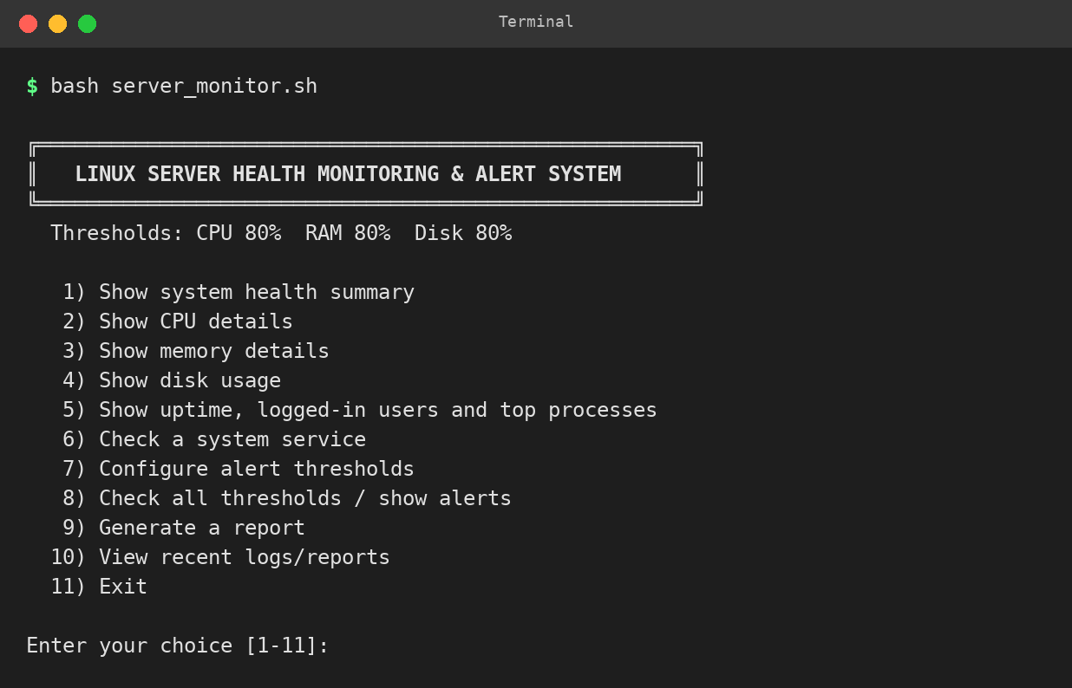
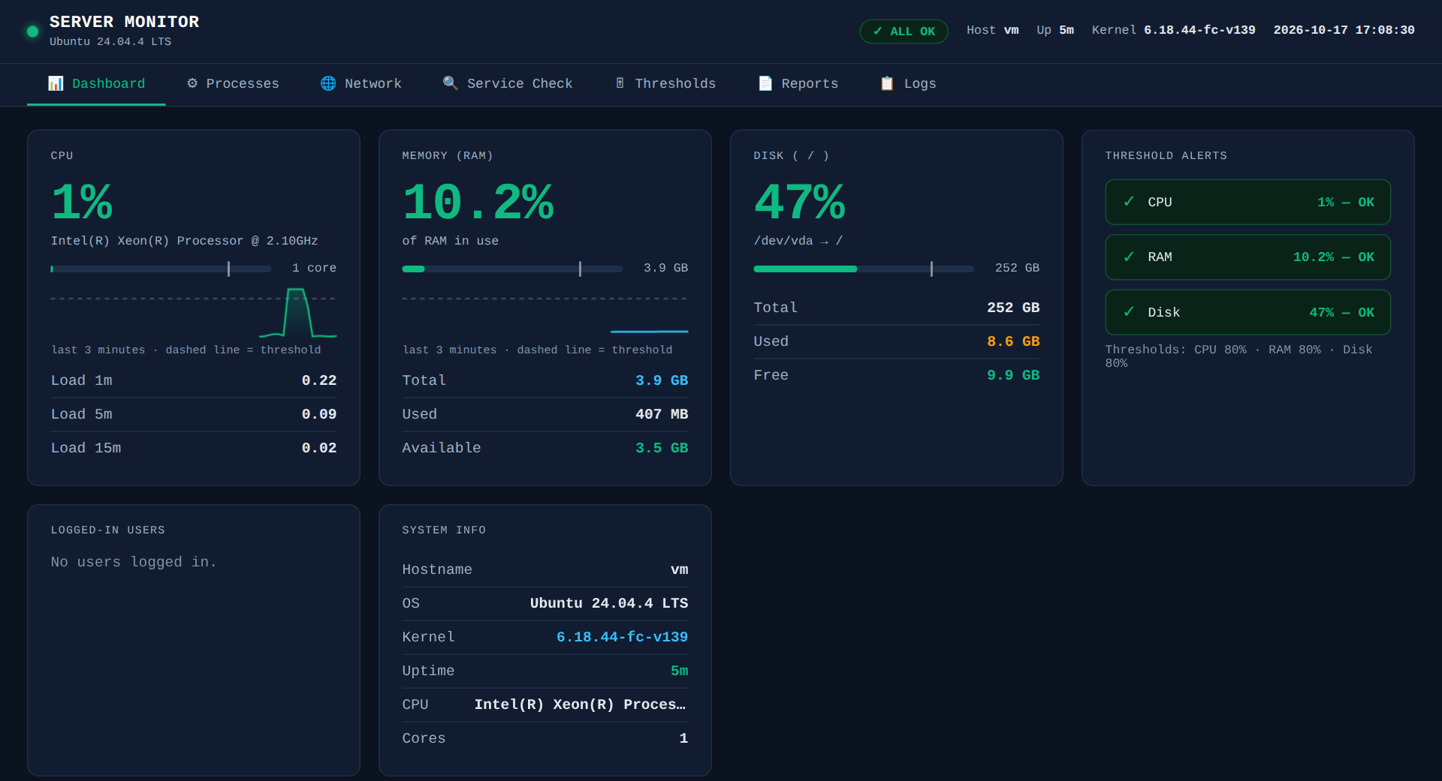
Process / Flow / Design Diagram
Menu / Web
terminal choice or browser request
Validate
menu number, threshold, service name
Collect
CPU, RAM, disk, users, processes
Alert Engine
value vs threshold
Report + Log
text files in data/
Data sources: /proc/stat, /proc/meminfo, df, ps, who, uptime, systemctl
Local storage: data/config.conf | data/logs/app.log | data/reports/report_*.txt

Slide 11

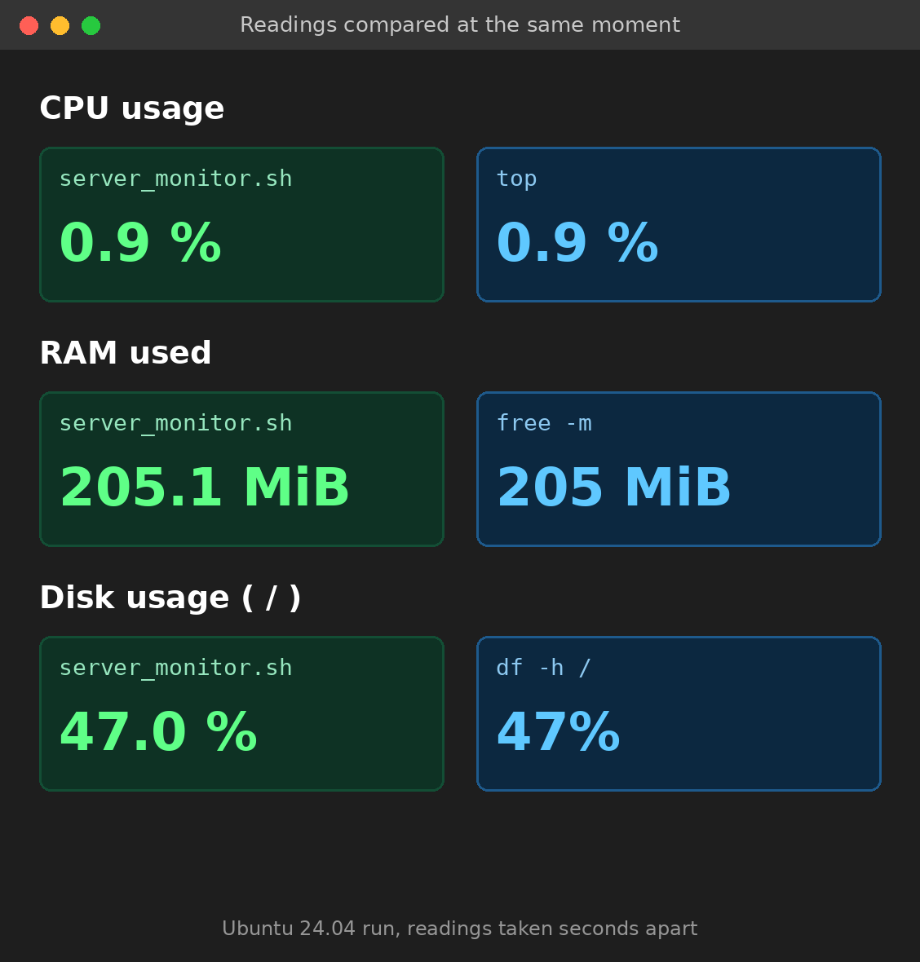
Experimentation
Readings: menus 2, 3 and 4 are compared with top, free -m and df -h / in a second terminal.
Alerts: thresholds set to 1 should give WARNING; set to 100 should give OK.
Bad input: 0, 101, abc and empty thresholds must be rejected and the old value kept.
Service check: a real service such as ssh, and an invalid name.
Reports and logs: menus 9 and 10 save and open a report and the log.
Web dashboard: every tab used in a Chromium browser (36 checks) plus 28 unit tests in web/test_app.py.
Test sheet: TEST_CHECKLIST.md has 76 test cases in 10 sections (A to J).

Slide 12
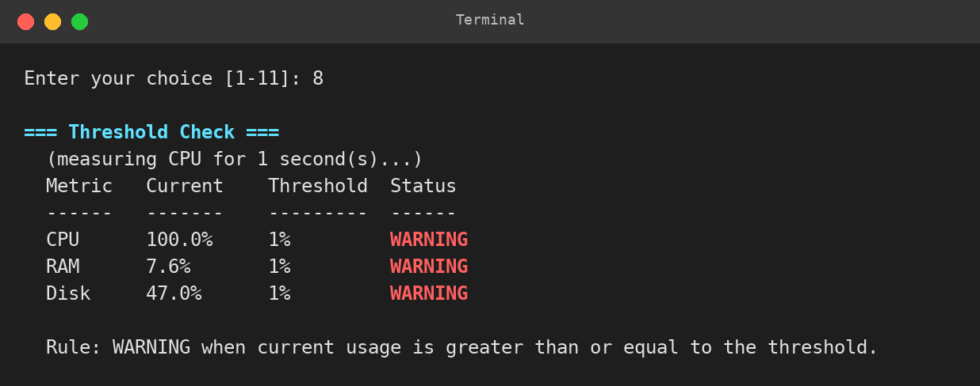
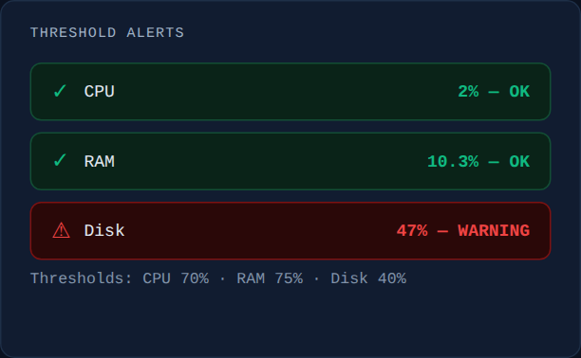
Results and Discussion
Developer pre-check (Ubuntu 24.04 sandbox, 76 tests): 58 done, 9 partial, 9 not run because they need a real VM with systemd or an interactive terminal.
RAM matched free -m and disk Use % matched df in the pre-check.
The alert rule works at the boundary: a CPU reading of 1.0 % against a threshold of 1 % gave WARNING.
Testing found three real bugs, now fixed: a crash on a bad report name, a stopped service shown as unknown, and a 129-character service name accepted.
Web dashboard: 28 unit tests and 36 browser checks passed; /api/metrics answers in about 4 ms (513 ms before optimisation).
Discussion: CPU is a 1-second sample, so it can differ slightly from top.

Slide 13
Conclusion & Future Directions
Conclusion
  A safe, read-only, beginner-friendly health monitor with a Bash terminal tool and a Flask web dashboard: real readings, validated thresholds, clear OK / WARNING alerts, and saved reports and logs.
  Limitations: current readings and a 3-minute chart only; the service check needs systemd; local machine only; the dashboard has no login, so it listens on localhost by default.
Future Directions
  E-mail or desktop notifications when a threshold is crossed (cron already repeats the checks and reports)
  Swap and disk I/O metrics
  Monitoring several servers over SSH
  A login for the web dashboard and a stored history for long-term charts

Slide 14

References
The Linux man-pages project, proc(5) manual page: the /proc filesystem. https://man7.org/linux/man-pages/man5/proc.5.html
Free Software Foundation, GNU Bash Reference Manual. https://www.gnu.org/software/bash/manual/
The Linux man-pages project, manual pages for df(1), ps(1), who(1), uptime(1) and free(1). https://man7.org/linux/man-pages/
systemd project, systemctl(1) manual page. https://www.freedesktop.org/software/systemd/man/latest/systemctl.html
Canonical Ltd., Ubuntu Server documentation. https://documentation.ubuntu.com/server/
Pallets Projects, Flask documentation. https://flask.palletsprojects.com/
Ubuntu Manpages, cron(8) and crontab(5). https://manpages.ubuntu.com/

